Slide 1
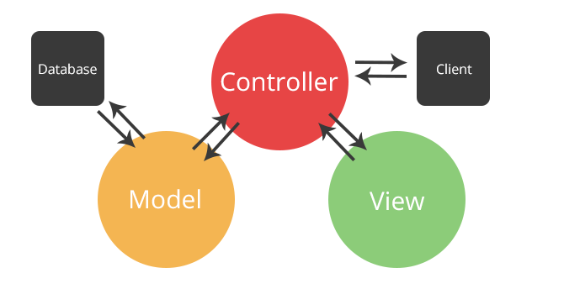
Introduction to MVC
Model-View-Controller
SoftUni Team
Technical Trainers
Software University
http://softuni.bg

Slide 2
Table of Contents
What is MVC?
What is its origin?
What is its idea?
What are the MVC Components?
What is a Model?
What is a View?
What is a Controller?

Slide 3
Have a Question?
sli.do #csharp-web

Slide 4

The MVC Pattern

Slide 5
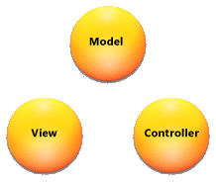
The MVC Pattern
Model–view–controller (MVC) is a software architecture pattern
Originally formulated in the late 1970s by Trygve Reenskaug as part of the Smalltalk
Code reusability and separation of concerns
Originally developed for desktop, then adapted for internet applications

Slide 6
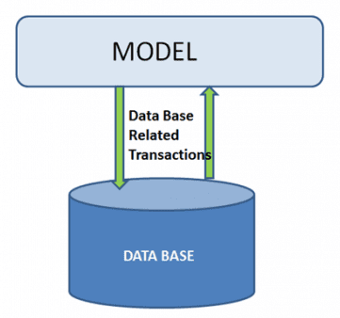
Model
The Model in MVC represents:
A set of classes that describes the data we are working with
Rules for how the data can be manipulated
May contain data validation rules
Often encapsulate persisted data
Most likely a Data Access Layer of some kind
Doesn't have significance in the framework, apart from giving the data objects

Slide 7


View
The View in MVC represents:
Defines how the application’s user interface (UI) will be displayed
May support Master Views (layouts) and Sub-Views (partial views or controls)
Web: Template to dynamically generate HTML

Slide 8
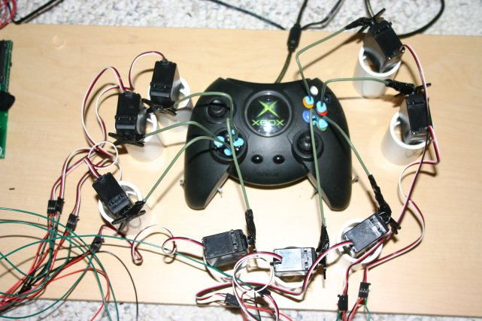
Controller
The Controller in MVC represents:
The core MVC component
Process the requests with the help of Views and Models
A set of classes that handles
Communication from the user
Overall application flow
Application-specific logic
Every Controller has one or more "Actions"

Slide 9
MVC Steps
Incoming Request routed to Controller
For web: HTTP Request
Controller processes Request and creates a Presentation Model
Controller also selects appropriate result (for example: View)
Model is passed to the View
The View transforms Model into appropriate output format (HTML)
Response is rendered (HTTP Response)

Slide 10
The MVC Pattern for Web
HTTP Request
Front controller (dispatcher)
/Some/Page/
Delegate request
User
Controller
HTTP Response
CRUD model
Select view & pass data
View
(render UI)
Model (data)
Use model data

Slide 11
Overall Architecture
Repository
Service
Controller
Database
View
Entities
Models / DTO
Back-End

Slide 12
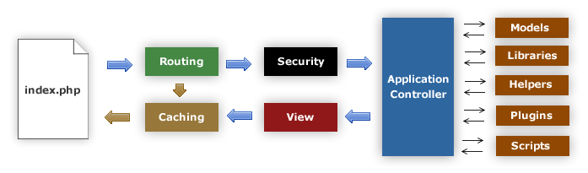
MVC Frameworks
CakePHP (PHP)
CodeIgniter (PHP)
Spring (Java)
Perl: Catalyst, Dancer
Python: Django, Flask, Grok
Ruby: Ruby on Rails, Camping, Nitro, Sinatra
JavaScript: AngularJS, JavaScriptMVC, Spine
ASP.NET MVC (.NET Framework)
ASP.NET Core (.NET Core)

Slide 13
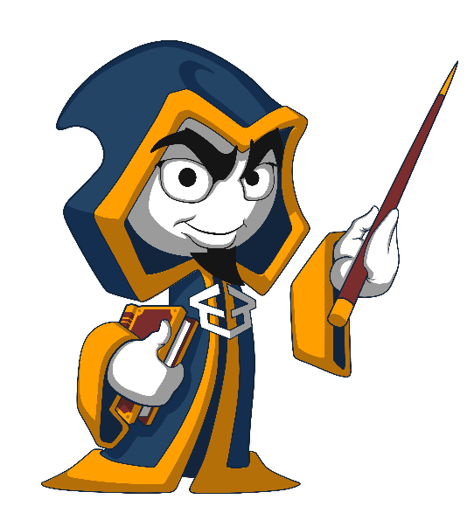
Summary
MVC is an architectural design pattern
Originally developed for Desktop apps only
Later met its application in the Web.
MVC Components
Model – The Data Component
View – The Presentation Component
Controller – The Functional Component
…
…
…

Slide 14
https://softuni.bg/trainings/courses

Slide 15



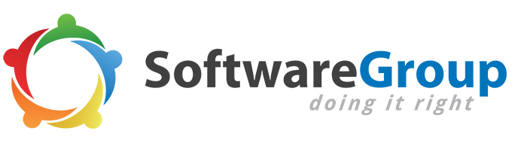






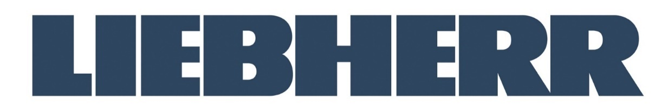


SoftUni Diamond Partners

Slide 16

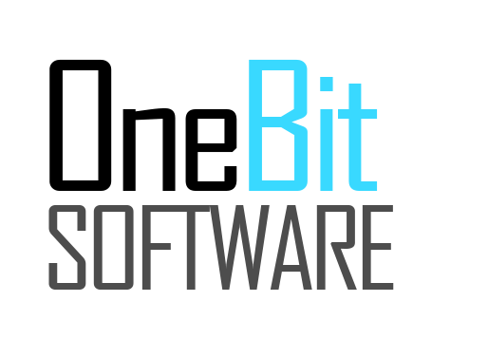



SoftUni Organizational Partners

Slide 17




Trainings @ Software University (SoftUni)
Software University – High-Quality Education and Employment Opportunities
softuni.bg
Software University Foundation
http://softuni.foundation/
Software University @ Facebook
facebook.com/SoftwareUniversity
Software University Forums
forum.softuni.bg

Slide 18
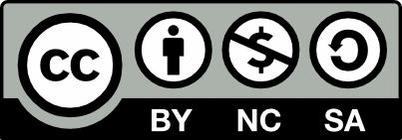
License
This course (slides, examples, demos, videos, homework, etc.) is licensed under the "Creative Commons Attribution-NonCommercial-ShareAlike 4.0 International" license

